Slide 1
SAP UI5 – Beginner Level

Slide 2
UI5B-OVW1-01 : Introduction HTML

Slide 3
UI5B-OVW1-01 : Introduction HTML

Slide 4
What is HTML?
HTML stands for Hyper Text Markup Language
HTML describes the structure of Web pages using markup
HTML elements are the building blocks of HTML pages
HTML elements are represented by tags
HTML tags label pieces of content such as "heading", "paragraph", "table", and so on
Browsers do not display the HTML tags, but use them to render the content of the page

Slide 5
Continued
HTML tags are element names surrounded by angle brackets:
<tagname>content goes here...</tagname>
HTML tags normally come in pairs like <p> and </p>
The first tag in a pair is the start tag, the second tag is the end tag
The end tag is written like the start tag, but with a forward slash inserted before the tag name
Tip: The start tag is also called the opening tag, and the end tag the closing tag.

Slide 6
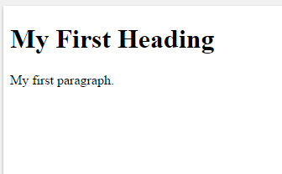
Example for HTML
<!DOCTYPE html> <html> <head> <title>Page Title</title> </head> <body> <h1>My First Heading</h1> <p>My first paragraph.</p> </body> </html>

Slide 7
Continued
The <!DOCTYPE html> declaration defines this document to be HTML5
The <html> element is the root element of an HTML page
The <head> element contains meta information about the document
The <title> element specifies a title for the document
The <body> element contains the visible page content
The <h1> element defines a large heading
The <p> element defines a paragraph

Slide 8
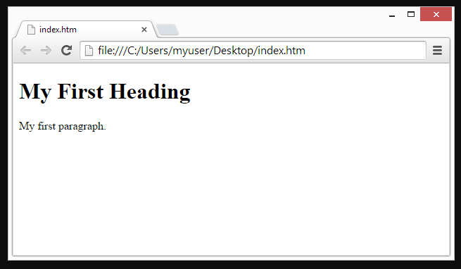
Use of Browser
The purpose of a web browser (Chrome, IE, Firefox, Safari) is to read HTML documents and display them.
The browser does not display the HTML tags, but uses them to determine how to display the document

Slide 9
New Features in HTML5
Multimedia Support
New HMTL5 Input Element Types
HTML5 Custom Data Attributes
Editable Contents in HTML5
HTML5 Autofocus and Placeholder Attributes
Required Field and Range Validators in HTML5
Local Storage
Pattern attribute for Regular Expressions

Slide 10
References
https://www.w3schools.com/html/
https://www.codecademy.com/learn/web

Slide 11
UI5B-OVW1-02 : Introduction JavaScript

Slide 12
What is JavaScript
JavaScript is the programming language of HTML and the Web.
JavaScript is a client side, interpreted, object oriented, high level scripting language, while Java is a client side, compiled, object oriented high level language.
JavaScript is a programming language that can be included on web pages to make them more interactive.

Slide 13
Continued
In HTML, JavaScript code must be inserted between <script> and </script> tags.
e.g.:
<script> document.getElementById("demo").innerHTML = "My First JavaScript"; </script>
A JavaScript function is a block of JavaScript code, that can be executed when "called" for.
For example, a function can be called when an event occurs, like when the user clicks a button.

Slide 14
Continued
You can place any number of scripts in an HTML document.
Scripts can be placed in the <body>, or in the <head> section of an HTML page, or in both.

Slide 15
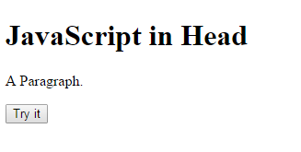
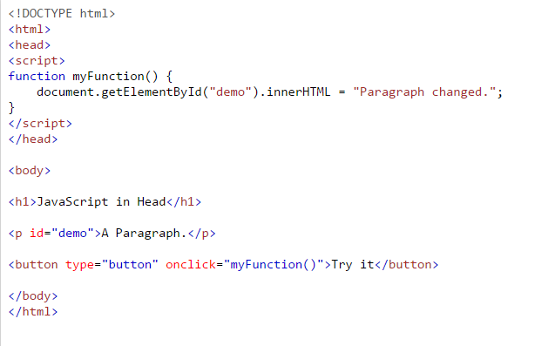
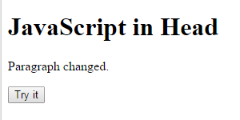
Example for JavaScript functions
BEFORE
AFTER

Slide 16
Example for JavaScript functions
Scripts can also be placed in external files
E.g.
function myFunction() { document.getElementById("demo").innerHTML = "Paragraph changed."; }
External scripts are practical when the same code is used in many different web pages.
JavaScript files have the file extension.js.

Slide 17
External JavaScript file
To use an external script, put the name of the script file in the src (source) attribute of a <script> tag
You can place an external script reference in <head> or <body> as you like.
<!DOCTYPE html> <html> <body> <script src="myScript.js"></script> </body> </html>

Slide 18
Advantages of External JavaScript File
Placing scripts in external files has some advantages
It separates HTML and code
It makes HTML and JavaScript easier to read and maintain
Cached JavaScript files can speed up page loads

Slide 19
Array
An array is a special variable, which can hold more than one value at a time.
If you have a list of items (a list of car names, for example), storing the cars in single variables could look like this:
var car1 = "Saab"; var car2 = "Volvo"; var car3 = "BMW";

Slide 20
Continued
However, what if you want to loop through the cars and find a specific one? And what if you had not 3 cars, but 300?
The solution is an array!
Using an array literal is the easiest way to create a JavaScript Array.
Syntax:
var array-name = [item1, item2, ...];
e.g.
var cars = ["Saab", "Volvo", "BMW"];

Slide 21
Continued
You refer to an array element by referring to the index number.
This statement accesses the value of the first element in cars
var name = cars[0];
E.g.
var cars = ["Saab", "Volvo", "BMW"]; document.getElementById("demo").innerHTML = cars[0];

Slide 22
Continued
Arrays are a special type of objects. The typeof operator in JavaScript returns "object" for arrays.
But, JavaScript arrays are best described as arrays.
Arrays use numbers to access its "elements". In this example, person[0] returns John:
e.g.
var person = ["John", "Doe", 46];
Objects use names to access its "members". In this example, person.firstName returns John:
e.g.
var person = {firstName:"John", lastName:"Doe", age:46};

Slide 23
Methods of Array
toString() converts an array to a string of (comma separated) array values.
join() method also joins all array elements into a string.
pop() method removes the last element from an array.
push() method adds a new element to an array (at the end).
shift() method removes the first array element and "shifts" all other elements to a lower index.

Slide 24
References
https://www.w3schools.com/js/
https://www.codecademy.com/learn/javascript

Slide 25
UI5B-OVW2: Overview of JSON, jQuery and CSS

Slide 26
UI5B-OVW2-01 : Introduction JSON

Slide 27
What is JSON?
JSON stands for JavaScript Object Notation
JSON is lightweight data interchange format
JSON is language independent *
JSON is "self-describing" and easy to understand
JSON is a format for storing and transporting data.
JSON is often used when data is sent from a server to a web page.

Slide 28
Example of JSON
This JSON syntax defines an employees object: an array of 3 employee records (objects)
{ "employees":[ {"firstName":"John", "lastName":"Doe"}, {"firstName":"Anna", "lastName":"Smith"}, {"firstName":"Peter", "lastName":"Jones"} ] }

Slide 29
JSON syntax rules
Data is in name/value pairs
Data is separated by commas
Curly braces hold objects
Square brackets hold arrays

Slide 30
JSON Rules
JSON data is written as name/value pairs, just like JavaScript object properties.
A name/value pair consists of a field name (in double quotes), followed by a colon, followed by a value
e.g.
"firstName":"John“
JSON objects are written inside curly braces.
Just like in JavaScript, objects can contain multiple name/value pairs
{"firstName":"John", "lastName":"Doe"}

Slide 31
JSON Rules
JSON arrays are written inside square brackets.
Just like in JavaScript, an array can contain objects
"employees":[ {"firstName":"John", "lastName":"Doe"}, {"firstName":"Anna", "lastName":"Smith"}, {"firstName":"Peter", "lastName":"Jones"} ]
In the example above, the object "employees" is an array. It contains three objects.
Each object is a record of a person (with a first name and a last name).

Slide 32
References
https://www.w3schools.com/js/js_json_syntax.asp
https://www.codecademy.com/courses/javascript-beginner-en-xTAfX/0/1

Slide 33
UI5B-OVW2-02 : Introduction jQuery

Slide 34
What is jQuery?
The purpose of jQuery is to make it much easier to use JavaScript on your website.
Before you start studying jQuery, you should have a basic knowledge of:
HTML
CSS
JavaScript

Slide 35
What is jQuery?
jQuery is a lightweight, "write less, do more", JavaScript library.
jQuery takes a lot of common tasks that require many lines of JavaScript code to accomplish, and wraps them into methods that you can call with a single line of code.
jQuery also simplifies a lot of the complicated things from JavaScript, like AJAX calls and DOM manipulation.
The jQuery library contains the following features:
HTML/DOM manipulation
CSS manipulation
HTML event methods
Effects and animations
AJAX

Slide 36
Why jQuery?
There are lots of other JavaScript frameworks out there, but jQuery seems to be the most popular, and also the most extendable.
Many of the biggest companies on the Web use jQuery, such as:
Google
Microsoft
IBM
Netflix

Slide 37
jQuery Syntax
The jQuery syntax is tailor-made for selecting HTML elements and performing some action on the element(s).
Basic syntax is: $(selector).action()
A $ sign to define/access jQuery
A (selector) to "query (or find)" HTML elements
A jQuery action() to be performed on the element(s)
Examples:
$(this).hide() - hides the current element.
$("p").hide() - hides all <p> elements.
$(".test").hide() - hides all elements with class="test".
$("#test").hide() - hides the element with id="test".

Slide 38
What are Events?
All the different visitor's actions that a web page can respond to are called events.
An event represents the precise moment when something happens.
Examples:
moving a mouse over an element
selecting a radio button
clicking on an element
The term "fires/fired" is often used with events. Example: "The keypress event is fired, the moment you press a key".

Slide 39
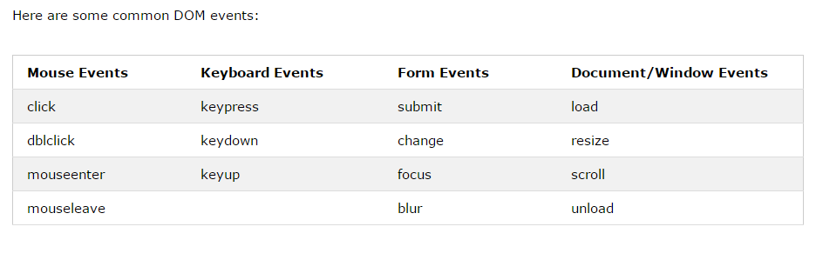
What are Events?

Slide 40
References
https://www.codecademy.com/courses/javascript-beginner-en-xTAfX/0/1

Slide 41
UI5B-OVW2-03 : Introduction CSS

Slide 42
What is CSS?
CSS stands for Cascading Style Sheets
CSS describes how HTML elements are to be displayed on screen, paper, or in other media
CSS saves a lot of work. It can control the layout of multiple web pages all at once
External stylesheets are stored in CSS files

Slide 43
Why use CSS?
CSS is used to define styles for your web pages, including the design, layout and variations in display for different devices and screen sizes.
CSS Solved a Big Problem when development of large websites, where fonts and color information were added to every single page, became a long and expensive process to solve this CSS was developed
CSS Saves a Lot of Work as the style definitions are normally saved in external .css files.
With an external stylesheet file, you can change the look of an entire website by changing just one file!

Slide 44
CSS syntax
The selector points to the HTML element you want to style.
The declaration block contains one or more declarations separated by semicolons.
Each declaration includes a CSS property name and a value, separated by a colon.
A CSS declaration always ends with a semicolon, and declaration blocks are surrounded by curly braces.

Slide 45
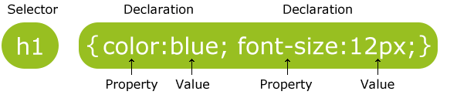
CSS syntax

Slide 46
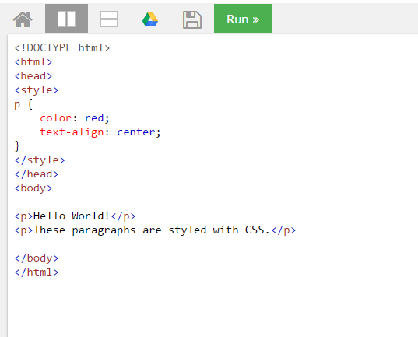
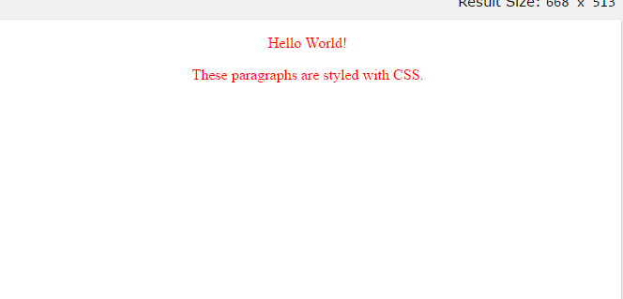
Example of CSS
OUTPUT

Slide 47
Advantages of CSS
CSS saves time − You can write CSS once and then reuse same sheet in multiple HTML pages. You can define a style for each HTML element and apply it to as many Web pages as you want.
Pages load faster − If you are using CSS, you do not need to write HTML tag attributes every time. Just write one CSS rule of a tag and apply it to all the occurrences of that tag. So less code means faster download times.
Easy maintenance − To make a global change, simply change the style, and all elements in all the web pages will be updated automatically.
Superior styles to HTML − CSS has a much wider array of attributes than HTML, so you can give a far better look to your HTML page in comparison to HTML attributes.

Slide 48
Continued
Multiple Device Compatibility − Style sheets allow content to be optimized for more than one type of device. By using the same HTML document, different versions of a website can be presented for handheld devices such as PDAs and cell phones or for printing.
Global web standards − Now HTML attributes are being deprecated and it is being recommended to use CSS. So its a good idea to start using CSS in all the HTML pages to make them compatible to future browsers.
Offline Browsing − CSS can store web applications locally with the help of an offline catche. Using of this, we can view offline websites. The cache also ensures faster loading and better overall performance of the website.

Slide 49
Continued
Platform Independence − The Script offer consistent platform independence and can support latest browsers as well.

Slide 50
UI5B-FIORI: Introduction to Fiori

Slide 51
UI5B-FIORI-01 : Overview of Fiori

Slide 52
What is SAP Fiori ?
SAP Fiori is a new user experience (UX) for SAP software and applications. It provides a set of applications that are used in regular business functions like work approvals, financial apps, calculation apps and various self-service apps.
SAP Fiori provides 800+ role-based applications like HR, Manufacturing, finance, etc. When you open the SAP Fiori home page application, you will see a picture of the flowers. It is because Fiori means ‘flowers’ in Italian
SAP Fiori provides all business roles in real time on compatible hand devices. It offers business roles on easy to use functions, simple with unmatched responsiveness on desktop, smart phones and Tablets.

Slide 53
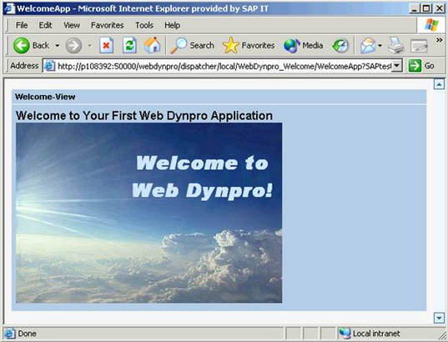
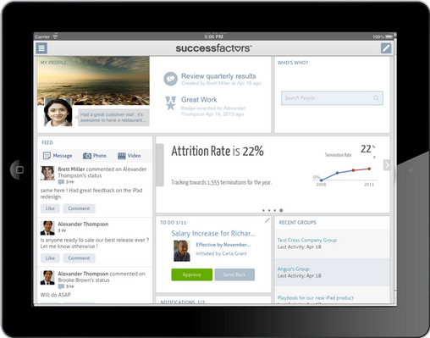
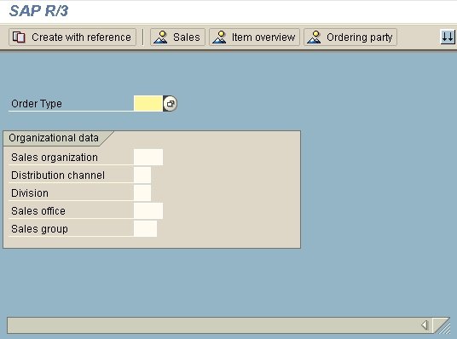
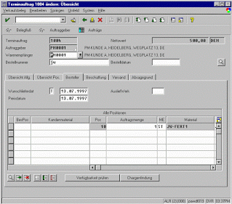
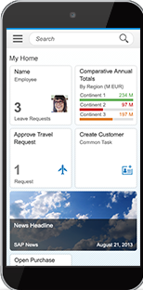
Continued
2014 – Fiori
2010 – Web Dynpro
2005 – ALV Grid
1999 – R/3

Slide 54
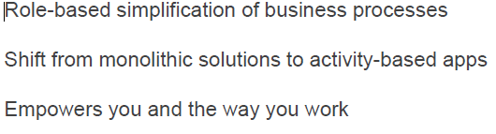
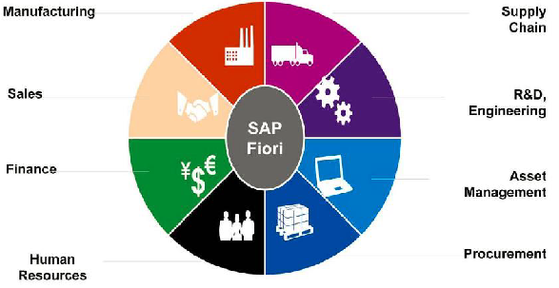
Continued

Slide 55
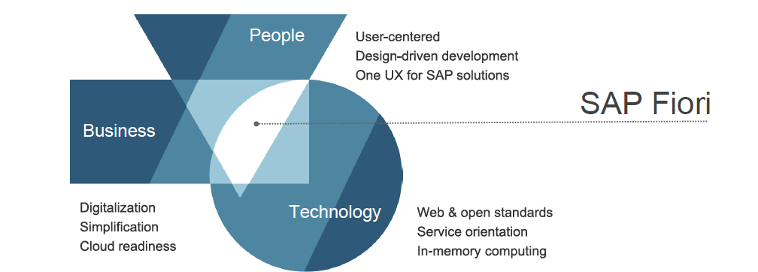
Continued

Slide 56
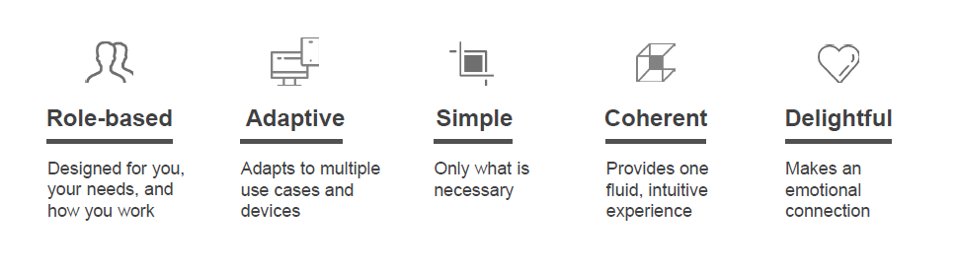
SAP Fiori design principles

Slide 57
Continued
Role-Based − SAP has decomposed various SAP transactions and changed them into beautiful user interactive applications that show only most relevant information to the users.
ADAPTIVE − When SAP Fiori is combined with the power of SAP HANA, it provides an unmatched application response and query executions time and adapts to multiple use cases and devices.
Simple − To make SAP Fiori simple to match the user demand, SAP has designed it as a 1-1-3 scenario. This means 1 user, 1 use case and 3 screens.

Slide 58
Continued
Coherent − SAP has provided all the Fiori apps based on the same language and it does not matter on the deployment and platform.
Delightful − SAP Fiori was designed to work with ECC 6.0 to make it easy for the users and to deploy on the existing SAP system.

Slide 59
Multi-Device Support
How can we make sure that we deliver a great user experience with our Fiori apps?
Responsive Design - One of the most compelling factors of SAP Fiori is that our applications need to be developed, configured and maintained only once for all changes to become effective across all devices.
Adaptive Design - It may only be required to view a small subset of data on your tablet or Smartphone as compared to the desktop

Slide 60
Responsive Design Concepts
Content density: Compact content density mode is activated on desktop mode. On touch devices, the finger-friendly cozy mode is activated.
Filters: On a desktop, the filter fields are fully displayed. On a tablet, the filter bar should be collapsed as default, so that users can work either with the filter dialog or with variants.
Table settings: While the grid-based analytical table runs perfectly on desktop and tablet, this would not be an option on a Smartphone. Instead, it would need to be replaced by a responsive table.

Slide 61
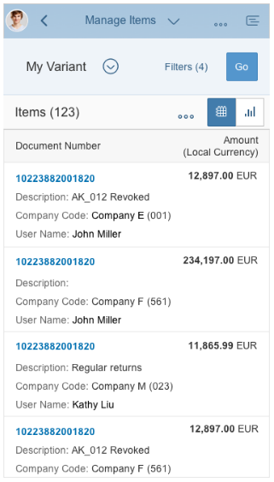
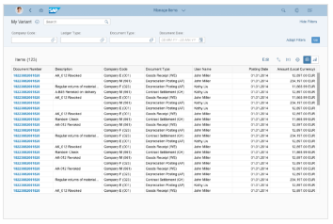
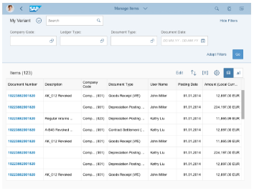
Examples of Responsive Designs
Mobile
Desktop
Tablet

Slide 62
UI5B-FIORI-02 : Overview of Fiori Launchpad

Slide 63
SAP Fiori Launchpad
KEY FACTS :
Web-based entry point to use SAP Business applications across platforms and devices.
Delivered as an out-of-the-box thinking to the I HTML client.
High productivity for end users using features like theming, search integration, customization, etc.
Offers single entry points for end users using multiple device types.

Slide 64
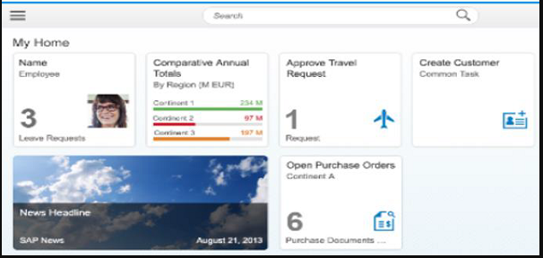
Continued
Fiori LAUNCHPAD

Slide 65
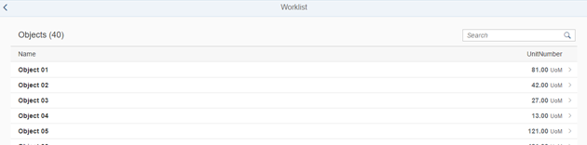
Fiori Templates
Worklist Template - A worklist displays a collection of items to be processed by the user and usually involves reviewing details of a list item and taking action.

Slide 66
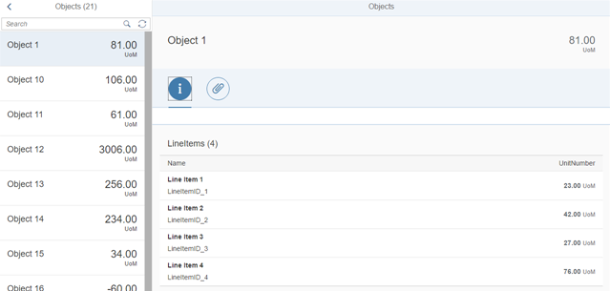
Continued
Master-Detail Template The split-screen layout is optimized for displaying and processing a list of items. On the left side of the screen, users can quickly scan and navigate through the list. On the right side, they then see the details of the selected item, and can trigger related actions or edit the data

Slide 67
UI5B-UI5: Introduction to UI5

Slide 68
UI5B-UI5-01 : Overview of UI5 Architecture and Libraries

Slide 69
Introduction
SAPUI5 is a client-side HTML5 and JavaScript-based rendering library that is optimized for consumption of SAP data
Well-designed API, easy to consume and use
High performance as its based on client side rendering
Control extensibility
SAP product standard compliant
Powerful theming support based on CSS
Based on open standards like OpenAjax, JavaScript, CSS, HTML5, jQuery and so on

Slide 70
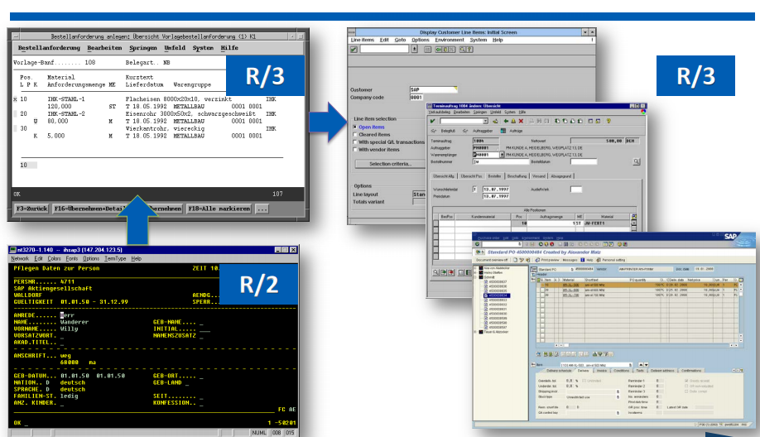
SAP UI Revolution & Evolution
FROM R/2 to R/3

Slide 71
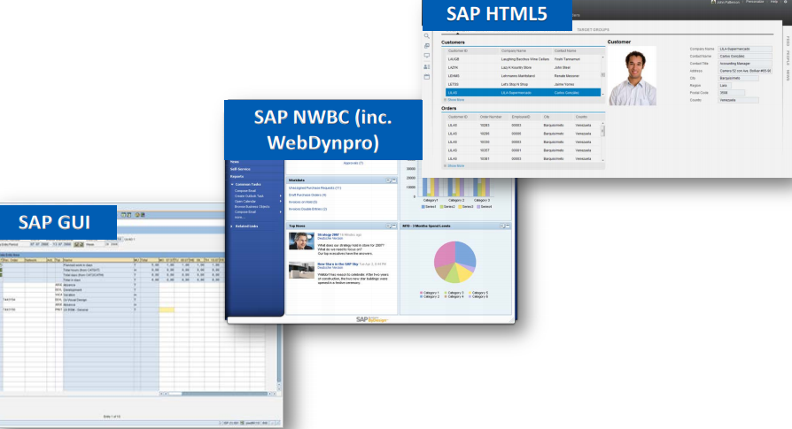
From SAP GUI to HTML5

Slide 72
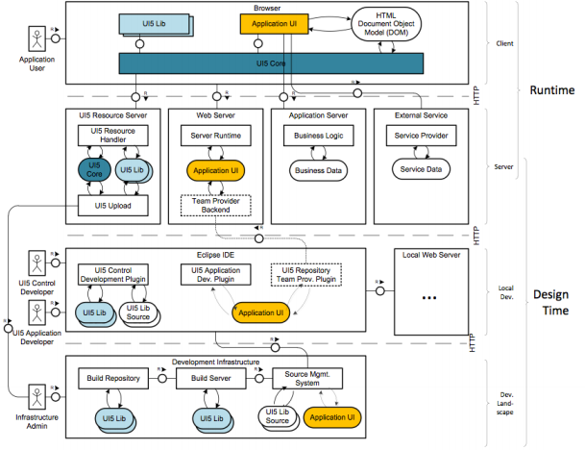
SAP UI5 : Architectural overview

Slide 73
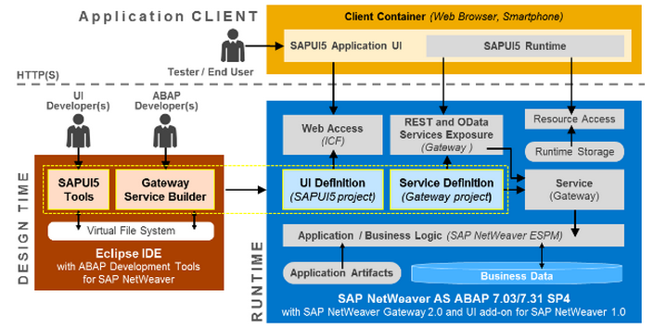
SAPUI5 Architecture Overview

Slide 74
Advantages: SAPUI5
SAPUI5 is device and Browser independent
Support all open source technology, Can be integrated with external libraries like D3.js and so on
Support Java, ABAP, HANA,NON SAP servers like Tomcat, Eclipse with UI5,
Ability to customize and extend the controls
Client side events
Mobile support
Support OData and json Models
Details on http://scn.sap.com/docs/DOC-51934

Slide 75
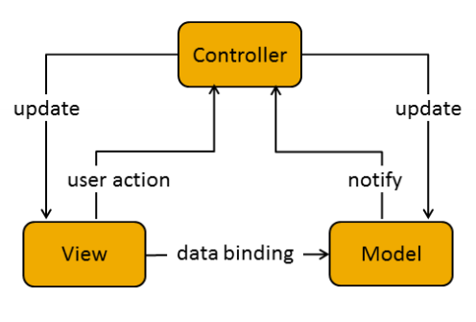
Model View Controller (MVC)
In the Model View Controller concept, the representation of information is separated from the user's interaction:
The view is responsible for defining and rendering the UI. (By placing all UI controls in view)
The model manages the application data.
The controller reacts to view events and user interaction by modifying the view and model. (Events, Navigation & UI Operations)

Slide 76
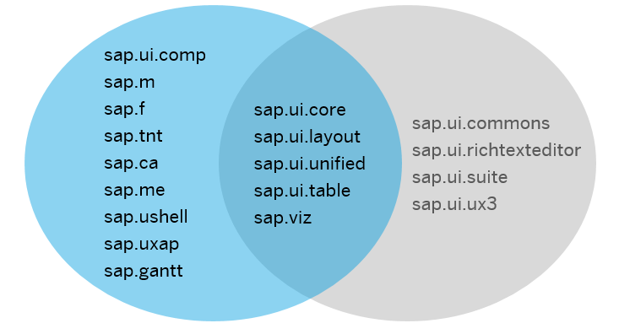
UI5 Libraries

Slide 77
Details Of Libraries
sap.ui.core : This library contains the jQuery plugins (jQuery.sap.*), the core and all its components, base classes for controls, components and the Model-View-Controller (MVC) classes.
sap.m : controls designed for mobile devices and tablets ,can also be used for desktop.
sap.ui.layout : contains all layout controls can be combined with other libraries
sap.ui.model : It is SAP UI5 Data binding API.
sap.ui.table : It contains all the table controls
sap.ui.view : Creates a view of the given type, name and with the given id.

Slide 78
Lifecycle Hooks of the View
onInit(): Called when a view is instantiated and its controls (if available) have already been created; used to modify the view before it is displayed to bind event handlers and do other one-time initialization
onExit(): Called when the view is destroyed; used to free resources and finalize activities
onAfterRendering(): Called when the view has been rendered and, therefore, its HTML is part of the document; used to do post-rendering manipulations of the HTML. SAPUI5 controls get this hook after being rendered.
onBeforeRendering(): Invoked before the controller view is re-rendered and not before the first rendering; use onInit() for invoking the hook before the first rendering

Slide 79
Chrome developer Tools and debugging UI5 applications
Elements section- Gives you the detail of the HTML DOM structure and CSS properties
Networks- All the get and Post call the browser is making
Sources- To see all the scripts
Resources- Cookies and Local storage
Console
Break points
Use shortcut keys for debugging

Slide 80
UI5B-UI5-02 : Creating a Simple UI5 App - exercise

Slide 81
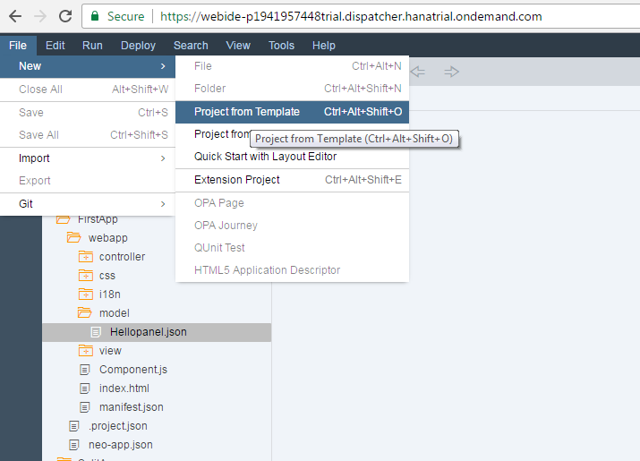
Creating SAP UI5 application
Create a new project

Slide 82
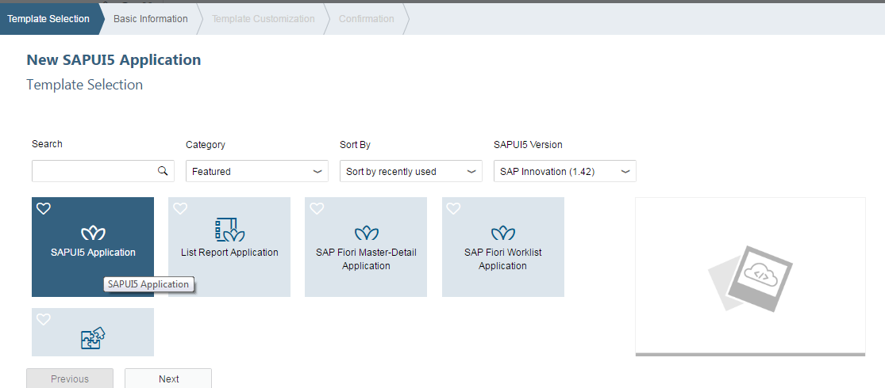
Creating SAP UI5 application
Select Application project from wizard

Slide 83
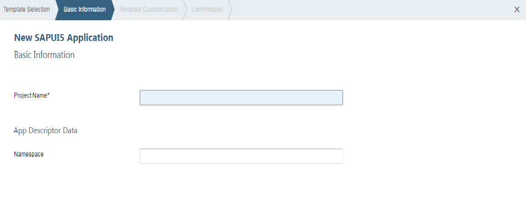
Creating SAP UI5 application
Enter the Project name, Select Library to be used

Slide 84
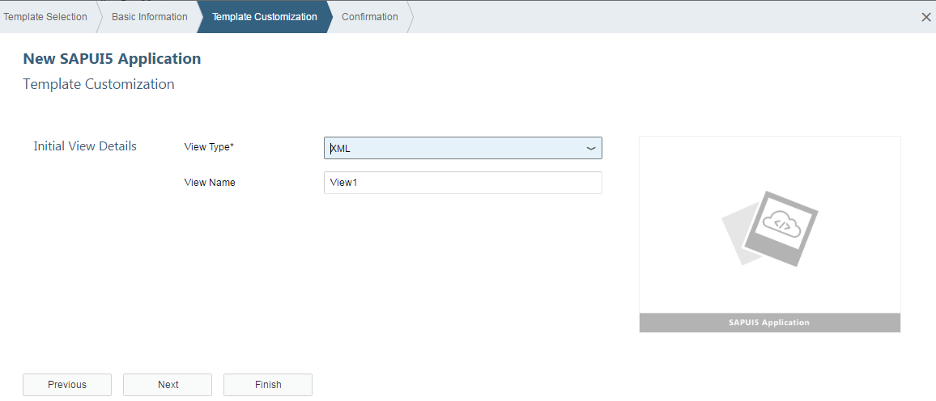
Creating SAP UI5 application
Give the name of Initial View and select the development paradigm

Slide 85
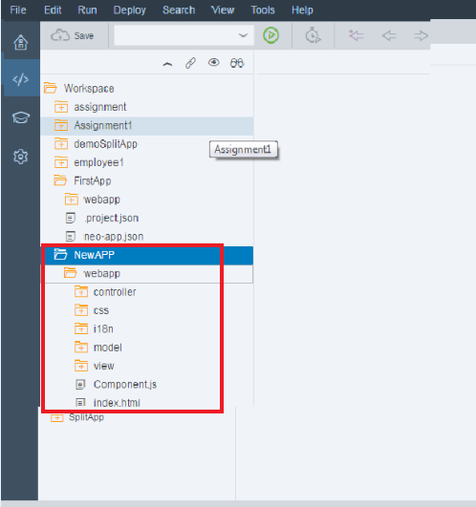
Creating SAP UI5 application
Project got created with Following structure

Slide 86
SAP UI5 Application Project Structure
<webapp_root_folder>
Application.js
css … all CSS files go here (and potentially related images)
style.css … and potentially more stylesheets
ext … all reused third party java script goes here
i18n … all property files for localization go here
i18n.properties
i18n_de.properties
i18n_en.properties
…
model
util .. all helper classes go here
view .. all view files go here; all file names shall start with an upper case letter
Controller all the controller files go here.
img … all image files go here (png, jpg, gif, …)
<someNamespace> all on-the-fly controls defined within the application go here
<controlName>.js
index.html

Slide 87
Resource Handling
In SAPUI5, resources are handled in a client-side and a server-side part.
Client-side Resource Handling
Modularization of JavaScript files
Localization of application texts with resource bundles
Server-side Resource Handling
For the Java server and the integration into Eclipse, SAPUI5 provides a resource handler to improve the interaction between client and server.It is also used to support modularized development of SAPUI5 applications and libraries.

Slide 88
SAPUI5 Components
Components are independent and reusable parts used in SAPUI5 applications.
SAPUI5 provides the following two types of components:
Faceless components (class: sap.ui.core.Component)
Faceless components do not have a user interface and are used, for example, for a service that delivers data from a back-end system.
UI components (class: sap.ui.core.UIComponent)

Slide 89
Structure of a component
A component is a folder. The folder name defines the component name and contains all optional and required resources.
component.js
This is the component controller and provides the runtime metadata (properties, aggregation, events) and the component methods. The name parameter that is passed to the component constructor represents the package name under which you can find the component.
component.json
This is the component descriptor and contains the design-time metadata. The file is not loaded during runtime. The file is currently not used, but may be used in the future for design-time tools.

Slide 90
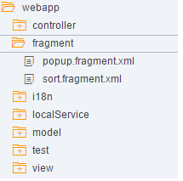
Fragments
Fragments is a technique used to split the codes into different files which will be dynamically called into a specified area in a UI5 page to get the final Output.
Fragments files are created with the extension <fragmentname>.fragment.xml.

Slide 91
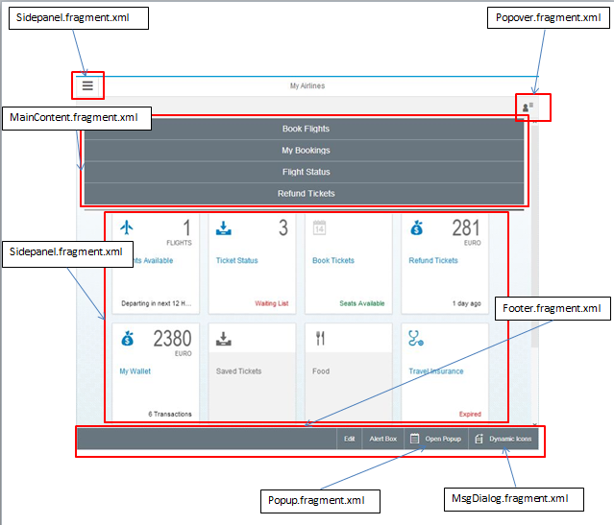

Fragment example
Fragments are called dynamically in the parent view by using the syntax as shown in the above screenshot

Slide 92
Types of views
XML Views
Javascript View
JSON View
HTML View
Types of models
OData Model
JSON Model
XML Model
Resource Model

Slide 93
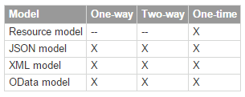
Types of Bindings
Property Binding
Aggregation Binding
Element Binding

Slide 94
Models and Data Binding
Data binding is used to bind two data sources or information sources together and to keep them in synch.
Model instances hold the data and provide the methods required to set the data or to retrieve data from a server.
Types Of Bindings are
Property Binding
Aggregation Binding
Element Binding

Slide 95
Property Binding
To define a property binding on a control, the following two options exist:
In the settings object in the constructor of a control
var oTextField = new sap.m.TextField(
{
value: "{/company/name}“
});
Using the bindProperty method of a control
oTextField.bindProperty("value", "/company/name");

Slide 96
Aggregation Binding
You can define aggregation binding either in the settings object in the constructor or by calling the bindAggregation method.
Binding through Settings object
var oItemTemplate = new sap.ui.core.ListItem(
{
text:"{name}“
});
var oComboBox = new sap.m.ComboBox(
{
items: { path: "/company/contacts", template: oItemTemplate }
});
Binding through bindAggregation method
oComboBox.bindAggregation("items", "/company/contacts", new sap.ui.core.ListItem(
{
text:"{name}“
}));

Slide 97
Element Binding
Binding an element allows to set the binding context of the element to the object referenced by the given binding path.
To define an element binding, use the bindElement method on a control:
var oLayout = new sap.ui.layout.VerticalLayout();
oLayout.bindElement("/company");
oLayout.addContent(
new sap.m.Label({text: "Name:"}),
new sap.m.TextField({value: "{name}"})
);

Slide 98
Useful links
SAP UI5 Demo kit- https://sapui5.hana.ondemand.com/sdk/#content/Controls/index.html
SCN Community page- http://scn.sap.com/community/developer-center/front-end
SAP UI5 testsuite- https://sapui5.hana.ondemand.com/sdk/test-resources/testsuite/testframe.html
Creating SAP UI5 Project http://scn.sap.com/docs/DOC-37805

Slide 99

Questions???

Slide 100


